Slide 1


“Advanced C Programming”
eDESD-2021

Slide 2
File I/O

Slide 3
1. Introduction
Data files
Can be created, updated, and processed by C programs
Are used for permanent storage of large amounts of data
Storage of data in variables and arrays is only temporary

Slide 4
2. The Data Hierarchy
Data Hierarchy:
Bit – smallest data item
Value of 0 or 1
Byte – 8 bits
Used to store a character
Decimal digits, letters, and special symbols
Field – group of characters conveying meaning
Example: your name
Record – group of related fields
Represented by a struct or a class
Example: In a payroll system, a record for a particular employee that contained his/her identification number, name, address, etc.

Slide 5
2. The Data Hierarchy…
Data Hierarchy (continued):
File – group of related records
Example: Employee information file
Database – group of related files
1
DSSD
2
DAC
3
WiMC
File
4
DESD
5
DASS
1
DSSD
Record
1
Field
00000001
Byte (Stores 1)
1
Bit

Slide 6
2. The Data Hierarchy…
Data files
Record key
Identifies a record to facilitate the retrieval of specific records from a file
Sequential file
Records typically sorted by key

Slide 7
3. Files and Streams
C views each file as a sequence of bytes
File ends with the end-of-file (EOF) marker, Or, file ends at a specified byte.
Stream created when a file is opened
Provide communication channel between files and programs
Opening a file returns a pointer to a FILE
Example file pointers:
stdin - standard input (keyboard)
stdout - standard output (screen)
stderr - standard error (screen)

Slide 8
3. Files and Streams…
FILE structure
File descriptor
Index into operating system array called the open file table

Slide 9
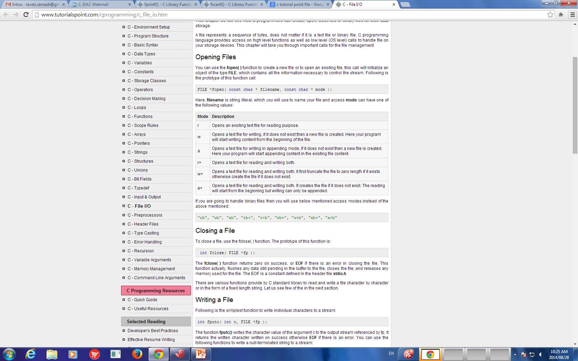
3. Files and Streams…
Table of file open modes:

Slide 10
3. Files and Streams…
Table of file open modes:
Mode | Operation | Description
r | Reading | Existing File
w | Writing | Truncate to zero length if file exists, Otherwise it creates a new file and writes from the beginning.
a | Append | Opens existing file if it exists, Otherwise it creates a new file and write from the end.
r+ | Reading Writing | Opens an existing file only, and can read or write.
w+ | Reading Writing | Existing file if exists. Otherwise it creates a new file. Writes from the beginning
a+ | Reading Appending | Existing file if exists. Otherwise it creates a new file. Writes from the end.

Slide 11
3. Files and Streams…
Read/Write functions in standard library
fopen - FILE *fopen(const char *filename, const char *mode)
opens the filename pointed to by filename using the given mode.
Example:
FILE * fp;
fp = fopen ("file.txt", "w+");
Arguments:
filename -- This is the C string containing the name of the file to be opened.
mode -- This is the C string containing a file access mode.
Return Value: This function returns a FILE pointer. Otherwise, NULL is returned.

Slide 12
3. Files and Streams…
Read/Write functions in standard library
fclose - int fclose(FILE *stream)
Closes the stream. All buffers are flushed.
Example:
FILE * fp;
fclose(fp);
Arguments:
stream -- This is the pointer to a FILE object that specifies the stream to be closed.
Return Value: This method returns zero if the stream is successfully closed. On failure, EOF is returned.

Slide 13
3. Files and Streams…
Read/Write functions in standard library
fgetc - c = fgetc(fp);
int fgetc(FILE *stream)
Gets the next character from the specified stream and advances the pointer to the next character in the stream.
Reads one character from a file
Takes a FILE pointer as an argument
Return Value: character read or EOF
fgetc(stdin) equivalent to getchar() & scanf(“%c”, &c)

Slide 14
3. Files and Streams…
Read/Write functions in standard library
fputc - fputc(ch, fp);
Declaration: int fputc(int char, FILE *stream)
Parameters:
char -- This is character to be written. This is passed as its int promotion.
stream -- This is the pointer to a FILE object that identifies the stream where the character is to be written.
Return Value -- If there are no errors, the same character that has been written is returned.If an error occurs, EOF is returned and the error indicator is set.
fputc( 'a', stdout ) equivalent to putchar( 'a' )

Slide 15
3. Files and Streams…
Read/Write functions in standard library
fgets
Declaration: char *fgets(char *str, int n, FILE *stream)
Reads a line from a file till the EOF or n characters are read
Arguments
str - array of chars where the string read is stored.
n -- This is the maximum number of characters to be read (including the final null-character)
stream -- This is the pointer to a FILE object
Return Value - On success, the function returns the same str parameter. If Error, NULL pointer is retured

Slide 16
3. Files and Streams…
Read/Write functions in standard library
fputs - int fputs(const char *str, FILE *stream)
Writes a string to the specified stream
Arguments
str -- This is an array containing the null-terminated sequence of characters to be written.
stream -- This is the pointer to a FILE object that identifies the stream
Return Value - This function returns a non-negative value else, on error it returns EOF.

Slide 17
3. Files and Streams…
Read/Write functions in standard library
fprintf - int fprintf(FILE *stream, const char *format, ...)
File processing equivalents of printf
Sends formatted output to a stream.
Arguments:
stream -- This is the pointer to a FILE object that identifies the stream.
format – Format specifiers
Return Value:
If successful, the total number of characters written is returned otherwise, a negative number is returned.

Slide 18
3. Files and Streams…
Read/Write functions in standard library
fscanf - int fprintf(FILE *stream, const char *format, ...)
File processing equivalents of scanf
Reads formatted input from a stream.
Arguments:
stream -- This is the pointer to a FILE object that identifies the stream.
format – Format specifiers
Return Value:
This function return the number of input items successfully matched and assigned, which can be fewer than provided for, or even zero in the event of an early matching failure.

Slide 19
4. Creating a Sequential Access File
Creating a File
FILE *myPtr;
Creates a FILE pointer called myPtr
myPtr = fopen("myFile.dat", openmode);
Function fopen returns a FILE pointer to file specified
Takes two arguments – file to open and file open mode
If open fails, NULL returned
fprintf
Used to print to a file
Like printf, except first argument is a FILE pointer (pointer to the file you want to print in)

Slide 20
4. Creating a Sequential Access File…
feof( FILE pointer )
Returns true if end-of-file indicator (no more data to process) is set for the specified file
fclose( FILE pointer )
Closes specified file
Performed automatically when program ends
Good practice to close files explicitly
Details
Programs may process no files, one file, or many files
Each file must have a unique name and should have its own pointer

Slide 21
4. Creating a Sequential Access File…
feof( FILE pointer )
Returns true if end-of-file indicator (no more data to process) is set for the specified file
fclose( FILE pointer )
Closes specified file
Performed automatically when program ends
Good practice to close files explicitly
Details
Programs may process no files, one file, or many files
Each file must have a unique name and should have its own pointer

Slide 22
File reading - fgetc
#include <stdio.h>
int main ()
{
//Declare a file pointer
FILE *fp;
char c;
//Open the file and check whether the file is opened or not
fp = fopen ("file1.txt", "r");
if (fp == NULL)
{
perror ("Error in opening file");
return (-1);
}
//Read characters from files and print to stdout
do
{
c = fgetc (fp);
if (c == EOF)
{
break;
}
fputc (c, stdout);
}
while (1);
//Close the file
fclose (fp);
return (0);
}

Slide 23
File reading - fgets
#include <stdio.h>
int main()
{
FILE *fp;
char str[60];
/* opening file for reading */
fp = fopen("file2.txt" , "r");
if(fp == NULL)
{
perror("Error opening file");
return(-1);
}
while (1)
{
if (fgets (str, 60, fp) != NULL)
{
/* writing content to stdout */
// puts(str);
fputs (str, stdout);
}
else
break;
}
fclose (fp);
return (0);
}

Slide 24
File writing and reading – fptus and fgets
#include <stdio.h>
int main ()
{
FILE *fp;
char str[60];
fp = fopen("file3.txt", "w+");
fputs("This is c programming.\n", fp);
fputs("This is a system programming language.", fp);
//after this fp points to the end of th file
rewind(fp); //fp points to the beginning of the file
while(1)
{
if( (fgets(str, 60, fp)) == NULL)
{
// printf("Error in reeading\n");
break;
}
else
printf("%s\n", str);
// fputs(str, stdout);
}
fclose(fp);
return(0);
}

Slide 25
File reading - fscanf
#include <stdio.h>
#include <stdlib.h>
int main()
{
char str1[40], str2[40], str3[40];
int year;
FILE * fp;
fp = fopen ("file4.txt", "w+");
fputs("We are in 2020\n", fp);
fputs("We are in 2021", fp);
rewind(fp);
fscanf(fp, "%[^\n]s", str1);
printf("Read String1: %s\n", str1 );
fscanf(fp, "%s %s %s %d", str1, str2, str3, &year);
printf("Read String1: %s\n", str1 );
printf("Read String2: %s\n", str2 );
printf("Read String3: %s\n", str3 );
printf("Read Integer: %d\n", year );
fclose(fp);
return(0);
}

Slide 26
1
2 /* Create a sequential file */
3 #include <stdio.h>
4
1. Initialize variables and FILE pointer
1.1 Link the pointer to a file
2. Input data
2.1 Write to file (fprintf)
3. Close file
5 int main()
6 {
7 int account;
8 char name[ 30 ];
9 double balance;
10 FILE *cfPtr; /* cfPtr = clients.dat file pointer */
11
12 if ( ( cfPtr = fopen( "clients.dat", "w" ) ) == NULL )
13 printf( "File could not be opened\n" );
14 else {
15 printf( "Enter the account, name, and balance.\n" );
16 printf( "Enter EOF to end input.\n" );
17 printf( "? " );
18 scanf( "%d%s%lf", &account, name, &balance );
19
20 while ( !feof( stdin ) ) {
21 fprintf( cfPtr, "%d %s %.2f\n",
22 account, name, balance );
23 printf( "? " );
24 scanf( "%d%s%lf", &account, name, &balance );
25 }
26
27 fclose( cfPtr );
28 }
29
30 return 0;
31 }

Slide 27
Enter the account, name, and balance.
Enter EOF to end input.
? 100 Jones 24.98
? 200 Doe 345.67
? 300 White 0.00
? 400 Stone -42.16
? 500 Rich 224.62
?
Program Output

Slide 28
5. Reading Data from a Sequential Access File
Reading a sequential access file
Create a FILE pointer, link it to the file to read
myPtr = fopen( "myFile.dat", "r" );
Use “fscanf” to read from the file
Like scanf, except first argument is a FILE pointer
fscanf( myPtr, "%d%s%f", &myInt, &myString, &myFloat );
Data read from beginning to end
File position pointer
Indicates number of next byte to be read / written
Not really a pointer, but an integer value (specifies byte location), Also called byte offset
rewind( myPtr )
Repositions file position pointer to beginning of file (byte 0)

Slide 29
2 /* Reading and printing a sequential file */
3 #include <stdio.h>
4
5 int main()
1. Initialize variables
1.1 Link pointer to file
2. Read data (fscanf)
2.1 Print
3. Close file
Program Output
6 {
7 int account;
8 char name[ 30 ];
9 double balance;
10 FILE *cfPtr; /* cfPtr = clients.dat file pointer */
11
12 if ( ( cfPtr = fopen( "clients.dat", "r" ) ) == NULL )
13 printf( "File could not be opened\n" );
14 else {
15 printf( "%-10s%-13s%s\n", "Account", "Name", "Balance" );
16 fscanf( cfPtr, "%d%s%lf", &account, name, &balance );
17
18 while ( !feof( cfPtr ) ) {
19 printf( "%-10d%-13s%7.2f\n", account, name, balance );
20 fscanf( cfPtr, "%d%s%lf", &account, name, &balance );
21 }
22
23 fclose( cfPtr );
24 }
25
26 return 0;
27 }
Account Name Balance
100 Jones 24.98
200 Doe 345.67
300 White 0.00
400 Stone -42.16
500 Rich 224.62

Slide 30
1
2 /* Credit inquiry program */
3 #include <stdio.h>
4
1. Initialize variables
2. Open file
2.1 Input choice
2.2 Scan files
3. Print
5 int main()
6 {
7 int request, account;
8 double balance;
9 char name[ 30 ];
10 FILE *cfPtr;
11
12 if ( ( cfPtr = fopen( "clients.dat", "r" ) ) == NULL )
13 printf( "File could not be opened\n" );
14 else {
15 printf( "Enter request\n"
16 " 1 - List accounts with zero balances\n"
17 " 2 - List accounts with credit balances\n"
18 " 3 - List accounts with debit balances\n"
19 " 4 - End of run\n? " );
20 scanf( "%d", &request );
21
22 while ( request != 4 ) {
23 fscanf( cfPtr, "%d%s%lf", &account, name,
24 &balance );
25
26 switch ( request ) {
27 case 1:
28 printf( "\nAccounts with zero "
29 "balances:\n" );
30
31 while ( !feof( cfPtr ) ) {
32

Slide 31
33 if ( balance == 0 )
34 printf( "%-10d%-13s%7.2f\n",
35 account, name, balance );
36
2.2 Scan files
3. Print
37 fscanf( cfPtr, "%d%s%lf",
38 &account, name, &balance );
39 }
40
41 break;
42 case 2:
43 printf( "\nAccounts with credit "
44 "balances:\n" );
45
46 while ( !feof( cfPtr ) ) {
47
48 if ( balance < 0 )
49 printf( "%-10d%-13s%7.2f\n",
50 account, name, balance );
51
52 fscanf( cfPtr, "%d%s%lf",
53 &account, name, &balance );
54 }
55
56 break;
57 case 3:
58 printf( "\nAccounts with debit "
59 "balances:\n" );
60
61 while ( !feof( cfPtr ) ) {
62
63 if ( balance > 0 )
64 printf( "%-10d%-13s%7.2f\n",

Slide 32
65 account, name, balance );
66
67 fscanf( cfPtr, "%d%s%lf",
68 &account, name, &balance );
3.1 Close file
69 }
70
71 break;
72 }
73
74 rewind( cfPtr );
75 printf( "\n? " );
76 scanf( "%d", &request );
77 }
78
79 printf( "End of run.\n" );
80 fclose( cfPtr );
81 }
82
83 return 0;
84 }

Slide 33
Enter request
1 - List accounts with zero balances
2 - List accounts with credit balances
3 - List accounts with debit balances
4 - End of run
? 1
Accounts with zero balances:
300 White 0.00
? 2
Accounts with credit balances:
400 Stone -42.16
? 3
Accounts with debit balances:
100 Jones 24.98
200 Doe 345.67
500 Rich 224.62
? 4
End of run.
Program Output

Slide 34
Binary file reading and writing
#include <stdio.h>
struct s
{
char name[50];
int height;
};
int main(){
struct s a,b;
FILE *fptr;
int i;
fptr=fopen("file.txt","wb");
for(i=0;i<5;++i)
{
//fflush(stdin);
printf("Enter name: ");
scanf("%s",a.name);
printf("Enter height: ");
scanf("%d",&a.height);
fwrite(&a,sizeof(a),1,fptr);
}
fclose(fptr);
fptr=fopen("file.txt","rb");
while(1)
{
if(fread(&b,sizeof(b),1,fptr)==1)
printf("Name: %s Height: %d\n",b.name,b.height);
else
break;
}
fclose(fptr);
}

Slide 35
fseek()
fseek
Sets file position pointer to a specific position
fseek( FILE *fp, offset, whence);
pointer – pointer to file
offset – Number of bytes to offset from whence
whence – Position from where offset is added
SEEK_SET – seek starts at beginning of file
SEEK_CUR – seek starts at current location in file
SEEK_END – seek starts at end of file

Slide 36
Thank You

